Slide 1

Deriving Water Temperature from Gridmet Daily Average Temperature
Halls Creek Narrows
https://www.nps.gov/care/planyourvisit/hallscreek.htm

Slide 2
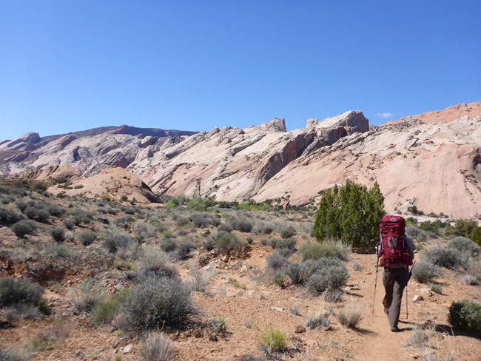
Goals
Develop tool to forecast and nowcast water temperature of Halls Creek Narrows for curious park visitors
Establish relationship between air temperature and water temperature of Halls Creek Narrows
https://www.nps.gov/care/planyourvisit/hallscreek.htm

Slide 3
Data Used
Gridmet Air Temperature
Max. Temperature, Min. Temperature, and Avg. Temperature
Can forecast 30 days out with Gridmet
Water Temperature
Data Logger
Collected between 2006 and 2021
62 data points
Earth.google.com

Slide 4
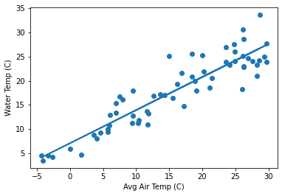
Average Daily Temperature found to be best proxy for Water Temperature
R² = 0.83744

Slide 5
Next Steps
Integrate Gridmet and Water temperature relationship into climateanalyzer.org for daily and forecasted water temperature in the Halls Creek Narrows
Continue collecting water temperature data to strengthen relationship between Gridmet Air temperature and water
Earth.google.com

